Slide 1


P185- (Bank Analytics) Bank Loan Of Customers
Presented By: (From Group 3)
Chandan,
Bhagyashri,
Shruti,
Mangesh,
CLIVE DOMINIC,
Harshith
Shubham.
MENTORS
DIPTI SINHA
VITHAL .B

Slide 2

AGENDA
Project Introduction
KPI'S Overview
EXCEL DASHBOARD
TABLEAU DASHBOARD
POWER BI DASHBOARD
CONCLUSION
Project Members and Files
REVIEW
THANK YOU

Slide 3

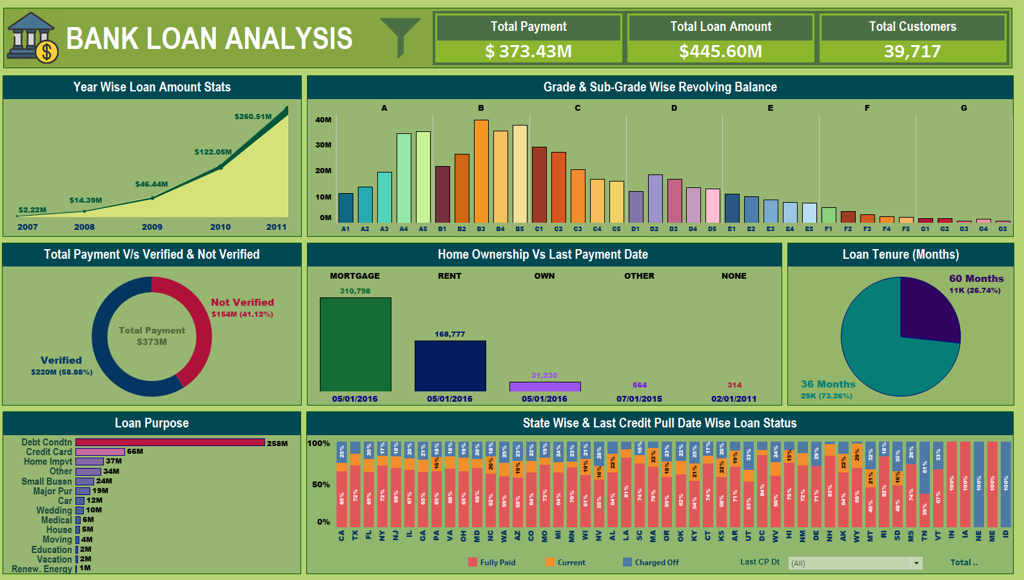
Project Introduction
The name of the project is “bank loan of customers” and it is under the
domain ‘finance’’.
Objective: Gain insights into the bank's lending operations using finance data.
KPIs Analyzed: Loan amounts, loan grades, verification statuses, loan status by state, and home ownership statistics.
Goal: Provide actionable information to optimize lending strategies and improve overall performance.
Data Sources: finance_1 and finance_2 datasets.
Analysis Areas: Explore loan trends, understand revolving balances by loan grades, compare payment behavior between verified and non-verified customers, and assess loan status variations across states and home ownership types.
Expected Outcomes: Comprehensive understanding of loan portfolio, customer payment patterns, and regional performance.
Used Tools : Excel, Power Bi, Tableau and SQL.

Slide 4

KPI’S OVERVIEW
KPI-1 : Year wise loan amount Stats
KPI-2 : Grade and sub grade wise revol_bal
KPI-3 : Total Payment for Verified Status Vs Total Payment for Non Verified Status
KPI-4 : State wise and last_credit_pull_d wise loan status
KPI-5 : Home ownership Vs last payment date stats

Slide 5
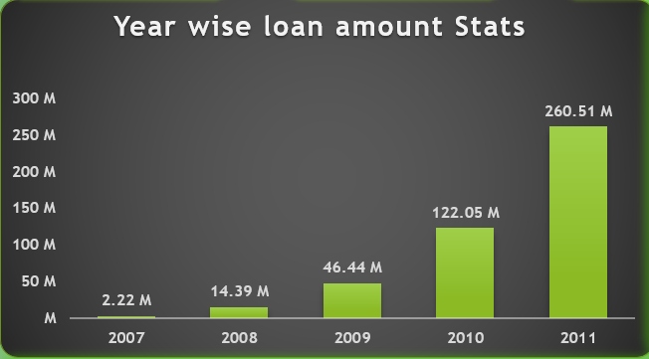
KPI-1 : Year wise loan amount Stats
Loan amount steadily increases over the years, showing growth in lending activities.
The loan amount increased by approximately 455% from 2007 to 2011.
The highest loan amount was in 2011, reaching 260.51 million dollars, indicating a surge in demand for loans.
2010 also saw substantial lending with 122.05 million dollars disbursed, reflecting a robust lending period.
The loan amounts were relatively lower in 2007 and 2008, possibly due to the financial crisis.
Overall, the total loan amount disbursed during the analyzed period is 445.60 million dollars, showing the bank's significant contribution to the lending market.

Slide 6
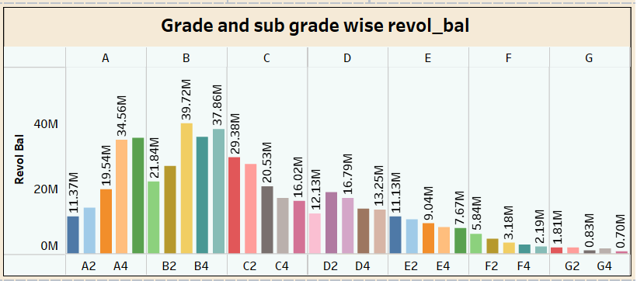
KPI-2 : Grade and sub grade wise revol_bal
Highest revolving balance in Grade B is 197.31 million dollars, followed by Grade A with 115.77 million dollars.
Sub-grade B3 has the highest revolving balance at 39.72 million dollars, indicating higher credit utilization.
Grades G and F have the lowest revolving balances, suggesting lower credit utilization and limits.
Grand total revolving balance is 531.51 million dollars, showcasing the bank's credit exposure.

Slide 7
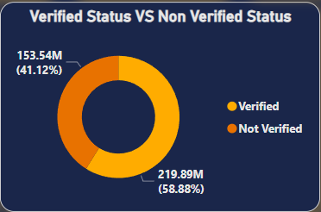
KPI-3 : Total Payment for Verified Status Vs Total Payment for Non Verified Status
Verified customers made payments of 219.89 million dollars, showing higher compliance than non-verified customers.
The grand total of 373.43 million dollars showcases the bank's strong financial position and successful loan collection.
Verification status distribution: 58.88% Verified and 41.12% Not Verified.
Not Verified customers contributed 153.54 million dollars to the bank's loan repayments.

Slide 8
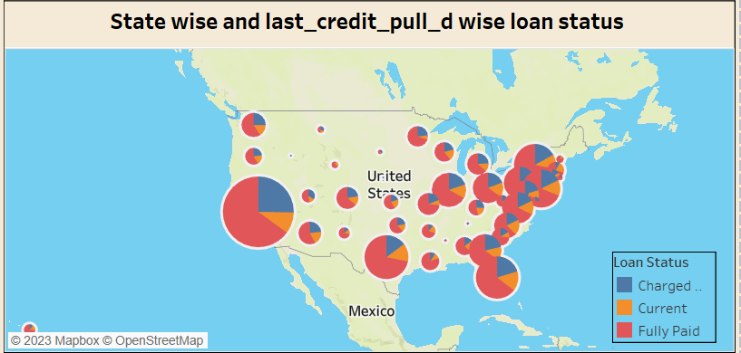
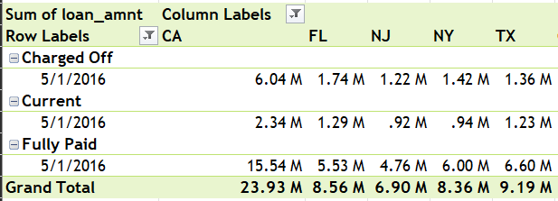
KPI-4 : State wise and last_credit_pull_d wise loan status
California (CA) leads with 23.93 million dollars in total loan status distribution as of May 1, 2016.
Texas (TX) ranks second with 9.19 million dollars in total loan status distribution.
Florida (FL) and New York (NY) closely follow with 8.56 million dollars and 8.36 million dollars, respectively.
New Jersey(NJ) has a distribution, with 6.90 million dollars across all three loan statuses.

Slide 9
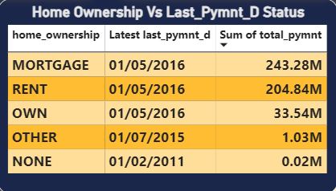
KPI-5 : Home ownership Vs last payment date stats
"MORTGAGE" home ownership made the highest total payments of 243.28 million dollars, the largest contribution to loan repayments.
"RENT" follows with 204.84 million dollars, showing diligent repayments among renters.
"OWN" homeowners contributed 33.54 million dollars, showcasing their commitment to timely repayments.
"OTHER" and "NONE" categories made smaller contributions of 1.03 million dollars and 0.02 million dollars, respectively.
The grand total of 482.70 million dollars represents overall loan repayments across all home ownership categories.

Slide 10
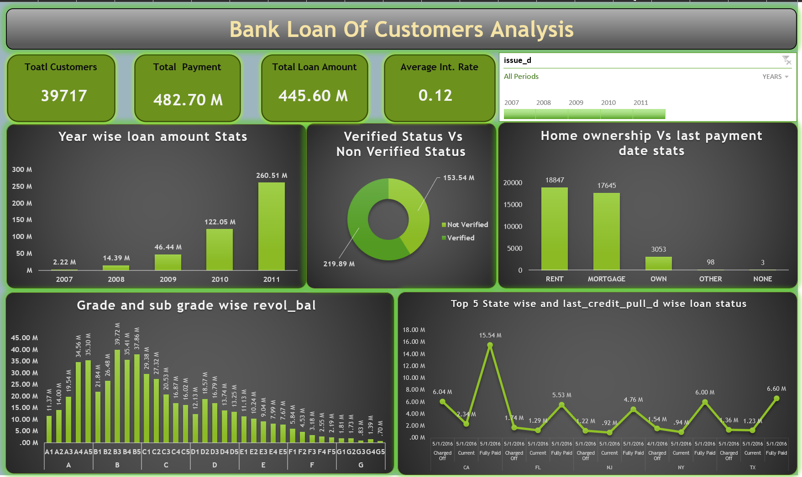
EXCEL DASHBOARD

Slide 11
TABLEAU DASHBOARD

Slide 12
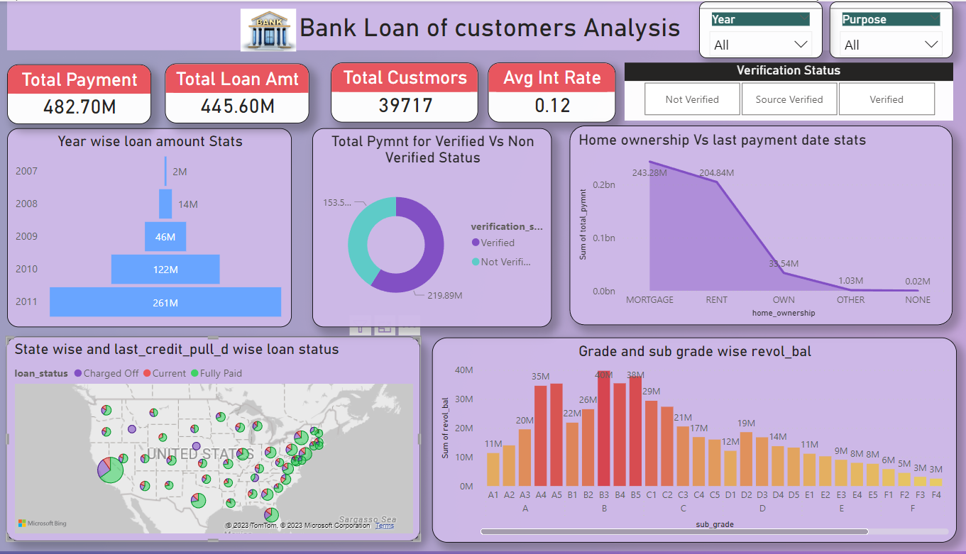
POWER BI DASHBOARD

Slide 13
CONCLUSION
In conclusion, The Bank Loan Analytics project provides valuable insights into lending operations, optimizing
strategies and improving performance through data-driven decisions, leading to increased profitability and customer satisfaction.
Key findings:
The loan amount is increasing year by year.
B grade type loan amount is the highest.
Verified loan account is lesser then the non verified one.
Most of the state have paid their loan fully.
The most loan taker for home ownership are the mortgage one .
Recommendations:
Make More Profit: Improve loan disbursements based on loan trends to earn more money.
Encourage Timely Payments: Make verification stronger to ensure people pay back on time and reduce risks.
Grade B Risk Control: Add extra checks for borrowers in grade B with higher revolving balances.
Focus on Busy Regions: Concentrate on places with more loan demand and growth potential, using state and home ownership data.

Slide 14
Project Members and Files
Project Members | Contact Information
Chandan Gope | chandangope032@gmail.com, 7903182523
Ms. Bhagyashri Hanmant Dhembare | b17dhembare@gmail.com, 9137730450
Mrs. Shruti Min | shrutimmin3@gmail.com, 8320454378
Mr. Mangesh Narendra Katkar | mangeshkatkar90@outlook.com, 8828375678
CLIVE DOMINIC ANDREWS | clivedandrews@gmail.com, 9849667334
Harshith C | harsha7237@gmail.com, 8892444874
Shubham Rajesh Kumar Singh | shubham.319651@gmail.com, 8652695407
Project Files:
Excel file:
Power BI file:
Tableau file:
SQL File:

Slide 15

REVIEW
Throughout this project, we learnt on-how to,
Import data
Clean data
Merged files
Creating relationship and analysing with different tools
Visualization
Showcasing the same kpi's on different tools
Working within team, helping and motivating each other

Slide 16
THANK YOU

